Slide 1
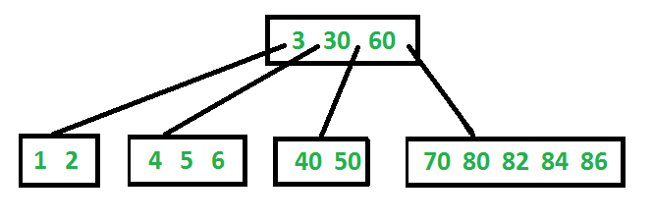
B-Tree
Reduce the number of disk accesses
All leaves are at same level
Defined by its minimum degree ‘t’
Every node except root must contain at least t-1 keys
  Root may contain minimum 1 key
All nodes (including root) may contain at most 2t – 1 keys
Number of children of a node is equal to the number of keys in it plus 1

Slide 2
B-Tree – Alternative Definition
B-Trees are specialized M-ary search trees
Each node has many keys
maximum branching factor of M
the root has between 2 and M children or at most L keys
other internal nodes have between ⎡M/2⎤ and M children
internal nodes contain only search keys (no data)
each (non-root) leaf contains between ⎡L/2⎤ and L keys
all leaves are at the same depth

Slide 3
B-Tree Example
B-Tree with M = 4
and L = 4
10
40
3
15
20
30
50
1
2
10
11
12
20
25
26
40
42
3
5
6
9
15
17
30
32
33
36
50
60
70

Slide 4
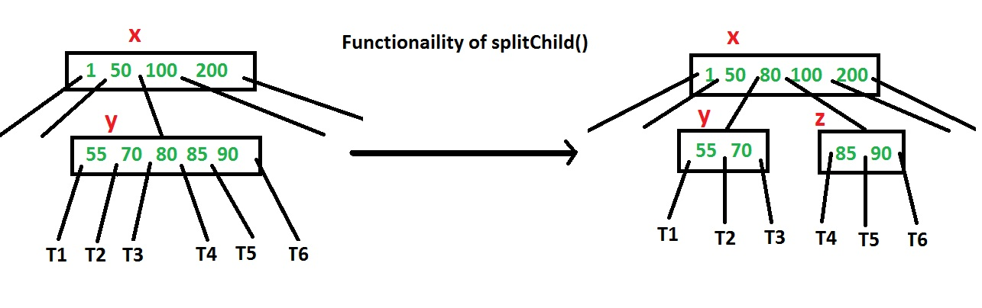
Insertion into B-Trees
new key is always inserted at leaf node
before inserting a key to node, we make sure that the node has extra space
use splitChild() to split a child of a node

Slide 5
Insertion into B-Trees
On the way to the insertion point, split each full node
The advantage of splitting before is, we never traverse a node twice

Slide 6


Insertion Example
tree of minimum degree t=3
insert integers 10, 20, 30, 40, 50, 60, 70, 80 and 90

Slide 7
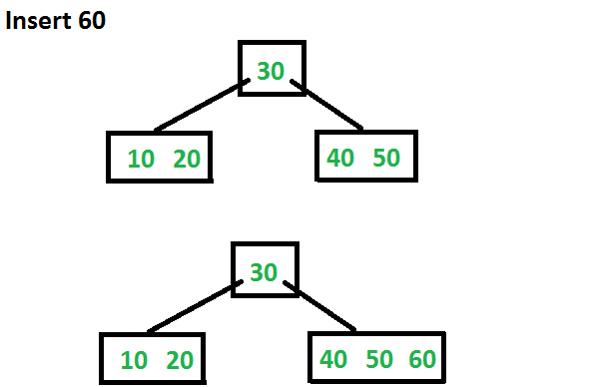
Insert 60

Slide 8
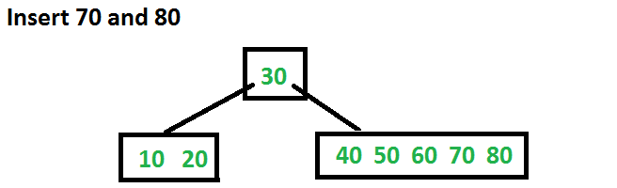
Insert 70 and 80

Slide 9
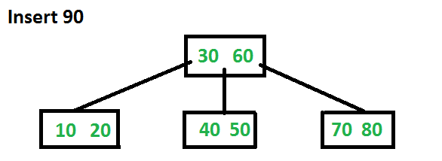
Insert 90

Slide 10
Deletion from B-trees
Ensure that a node doesn’t get too small during deletion
Back up if a node (other than the root) along the path to where the key is to be deleted has the minimum number of keys

Slide 11
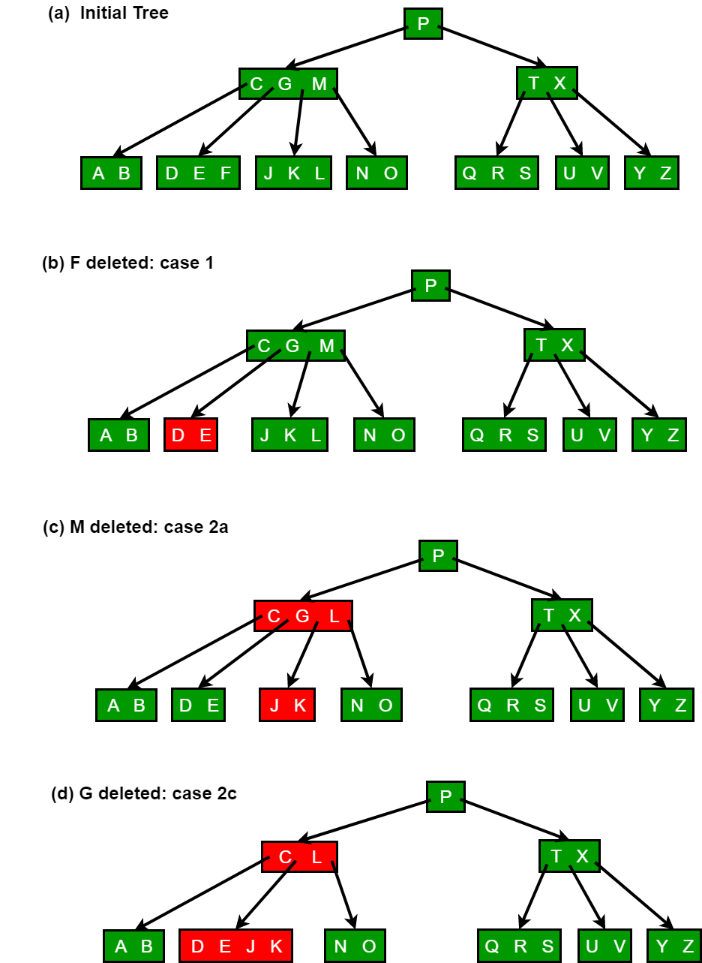
t=3
Delete F

Slide 12
Delete M

Slide 13
Delete G

Slide 14
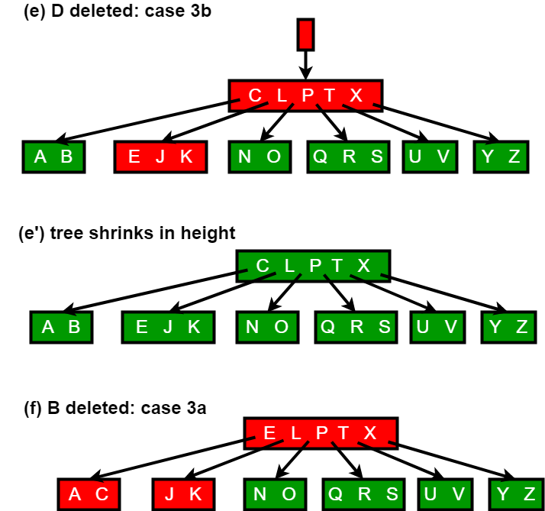
Delete D

Slide 15
Delete B

Slide 16
Efficiency of B-Trees
Often measured by number of disk accesses, instead of CPU comparisons
How many disk accesses are required for each search/insertion/deletion?
CPU running time. Assume we use sorted array as the internal data structure of the nodes
  for search?
  for insertion/deletion?

Slide 17
Balanced or Unbalanced?
Balanced search trees provide bounded time complexity
  AVL trees
  B-trees
Many applications require quick access to the tree data structures, and balanced trees offer guaranteed performance
In other applications, we may not care if the tree is balanced or not, as our objective is not to save running time
Compression is an example (save disk storage space, save the size of network transfer, etc)
Example: Huffman encoding

Slide 18
Fixed-length Character Encoding
A character encoding maps each character to a number.
Computers usually use fixed-length character encodings.
  (Extended) ASCII (American Standard Code for Information Interchange) uses 8 bits per character.
    A : 01000001
    B : 01000010
    C : 01000011
    …
    We can represent this encoding with a binary tree (height=8)
  Unicode uses 16 bits per character to accommodate foreign-language characters. (ASCII codes are a subset.)
Fixed-length encodings are simple, because
  all character encodings have the same length
  a given character always has the same encoding

Slide 19
Variable-length Character Encoding
Problem: fixed-length encodings waste space.
Solution: use a variable-length encoding.
  use encodings of different lengths for different characters
  assign shorter encodings to frequently occurring characters (could differ between different documents)
    E : 01
    O : 100
    S : 111
    T : 00
    TEST would be encoded as 000111100
Challenge 1: when decoding/decompressing an encoded document, how do we determine the boundaries between characters?
  example: for the above encoding, how do we know whether the next character is 2 bits or 3 bits?
Solution: no character’s encoding can be the prefix of another character’s encoding (e.g., couldn’t have T: 00 and a: 0).

Slide 20
Encoding Variants
Fixed Code
Naïve Variable
0
1
0
1
0
1
0
1
a
0
1
0
1
0
1
0
1
0
1
b
0
1
a
b
c
d
e
f
g
h
c
0
1
d
0
…
Char | Frequency | Fixed Code | Naïve variable | Better
a | 1,000,000 | 000 | 0 | 00
b | 999,999 | 001 | 10 | 01
c | 999,998 | 010 | 110 | 10
d | 10,000 | 011 | 1110 | 1100
e | 10,999 | 100 | 11110 | 1101
f | 10,998 | 101 | 111110 | 1110
g | 10,997 | 110 | 1111110 | 11110
h | 10,996 | 111 | 1111111 | 11111
e

Slide 21
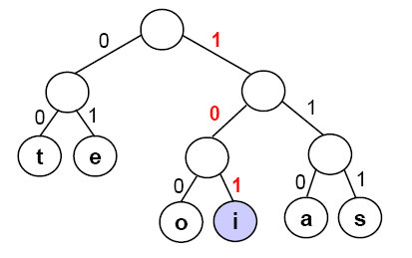
Huffman Encoding
Huffman encoding is a type of variable-length encoding that is based on the character frequencies in a given document.
Huffman encoding uses a binary tree:
  to determine the encoding of each character (encode an ASCII file)
  to decode an encoded file – i.e., to decompress a compressed file, putting it back into ASCII
Example of a Huffman tree (for alphabet with only six chars):
Leaf nodes are characters.
Left branches are labeled with a 0,
and right branches are labeled with a 1.
If we follow a path from root to leaf,
we get the encoding of the character in
the leaf. An example: 101 = ‘i’

Slide 22
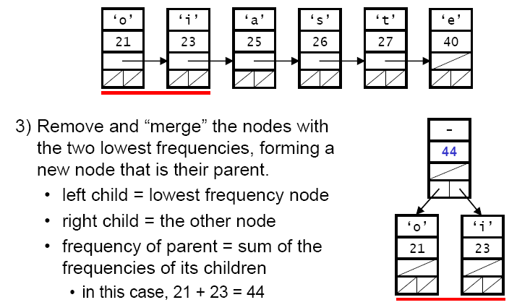
Building A Huffman Tree
Begin by reading through the text to determine the frequencies.
Create an (ordered) list of nodes that contain (character, frequency) pairs for each character that appears in the text.
Remove and “merge” the nodes with
the two lowest frequencies, forming a
new node that is their parent.
  left child = lowest frequency node
  right child = the next lowest frequency node
  frequency of parent = sum of the
  frequencies of its children

Slide 23
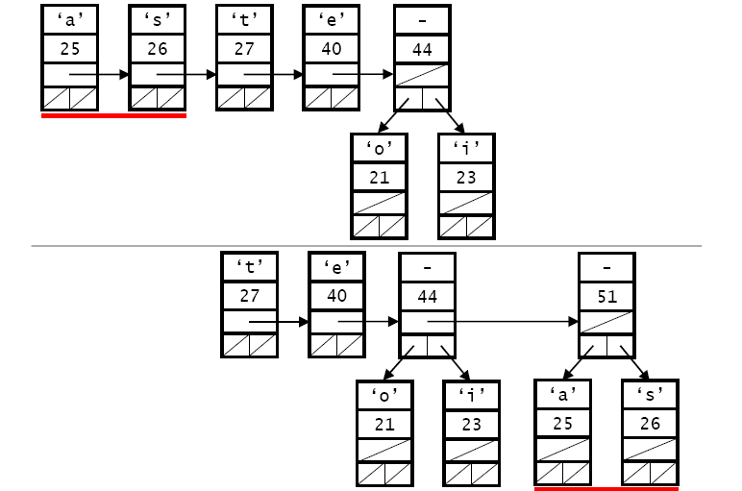
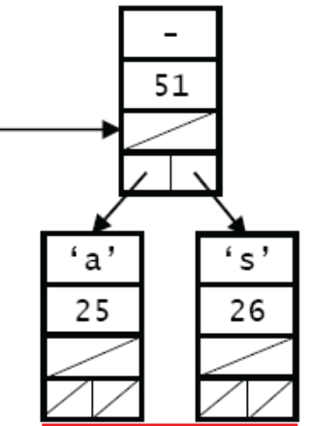
Building A Huffman Tree
Merge the two remaining nodes with the lowest frequencies:
  This is a greedy algorithm; a greedy algorithm attempts to get the optimal solution by finding currently the best move in each step

Slide 24
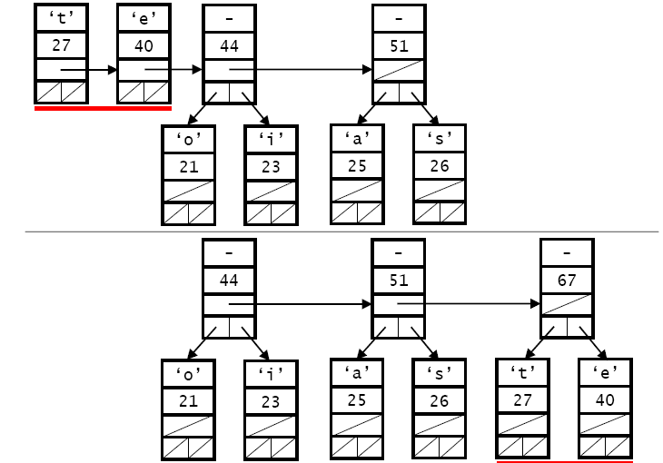
Building A Huffman Tree
It continues

Slide 25
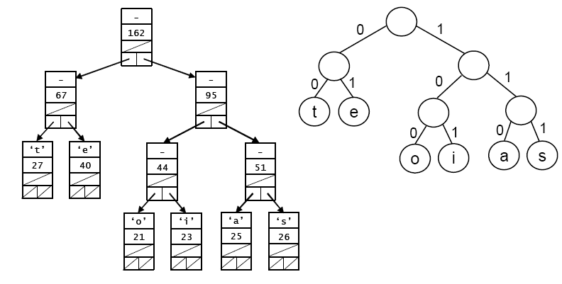
Building A Huffman Tree
The final tree, and character encoding

